Slide 1
Physical Design (Layout)
Nov. 18, 2015
Course Webpage: http://staff.ustc.edu.cn/~songch/da-ug.htm

Slide 2
Outline
Floorplanning
Placement
  Global Placement
  Detailed Placement
Routing
  Global Routing
  Detailed Routing
  Clock Routing

Slide 3
Floorplanning
Problem
  Given circuit modules (or cells) and their connections, determine the approximate location of circuit elements
  Consistent with a hierarchical / building block design/IP-based methodology
  Modules (result of partitioning, IP blocks):
    Fixed area, generally rectangular
    Fixed aspect ratio → hard macro (aka fixed-shaped blocks)
    fixed / floating terminals (pins)
    Rotation might be allowed / denied
    Flexible shape → soft macro (aka soft modules)
(w₁,h₁)
(w_{N},h_{N})

Slide 4
Floorplanning (cont.)
Objectives:
  Minimize area
  Determine best shape of soft modules
  Minimize total wire length
    to make subsequent routing phase easy
    (short wire length roughly translates into routability)
  Additional cost components:
    Wire congestion (exact routability measure), Wire delays, Power consumption, System throughput (e.g., CPI of a processor)
Possible additional constraints:
  Fixed location for some modules
  Fixed die, or range of die aspect ratio

Slide 5
Floorplanning: Why Important?
Early stage of physical design
  Determines the location of large blocks
  ➔ detailed placement easier (divide and conquer!)
  Estimates of area, delay, power
  ➔ important design decisions
  Impact on subsequent design steps (e.g., routing, heat dissipation analysis and optimization)
D
H
A
J
C
G
K
I
B
E
L
F
L
G
H
I
D
K
E
C
J
B
F
A

Slide 6
Sequence Pair (SP)
A floorplan is represented by a pair of permutations of the module names:
e.g. 1 3 2 4 5
3 5 4 1 2
A sequence pair (s₁, s₂) of n modules can represent all possible floorplans formed by the n modules by specifying the pair-wise relationship between the modules.

Slide 7
Example
Consider the sequence pair:
(13245,41352 )
Any other SP that is also valid for this packing?
3
2
1
5
4

Slide 8
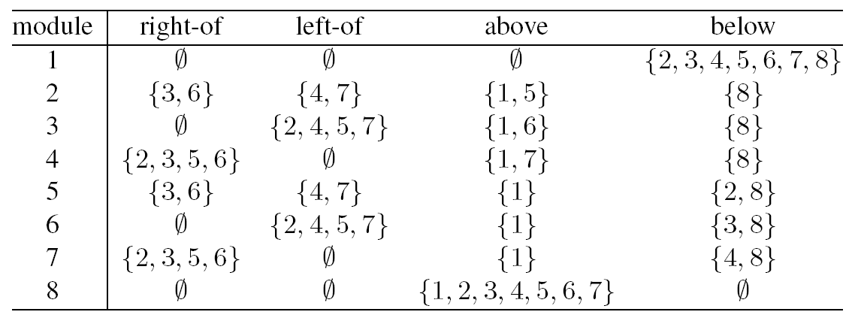
Sequence Pair To a Floorplan
Initial SP: SP₁ = (17452638, 84725361)
  Dimensions: (2,4), (1,3), (3,3), (3,5), (3,2), (5,3), (1,2), (2,4)
  Based on SP₁ we build the following table:

Slide 9
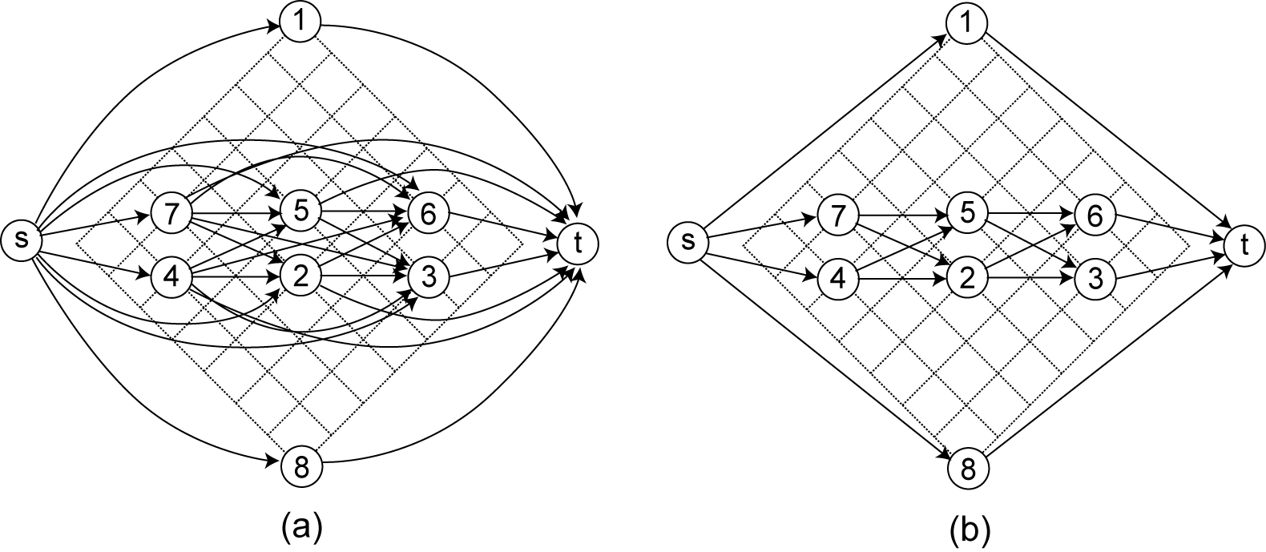
Constraint Graphs
Horizontal constraint graph (HCG)
  Before and after removing transitive edges

Slide 10
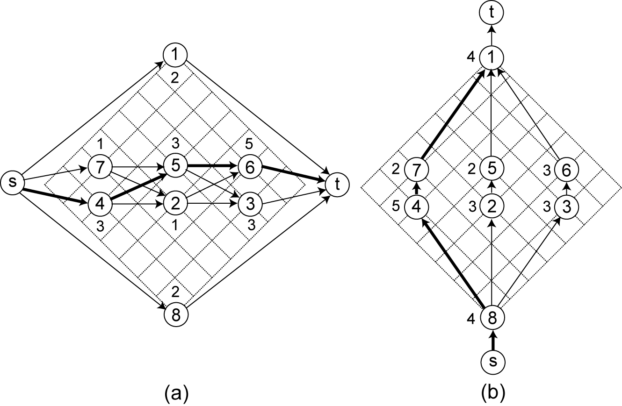
Computing Chip Width and Height
Longest source-sink path length in:
  HCG = chip width, (Vertical) VCG = chip height
  Node weight = module width/height

Slide 11
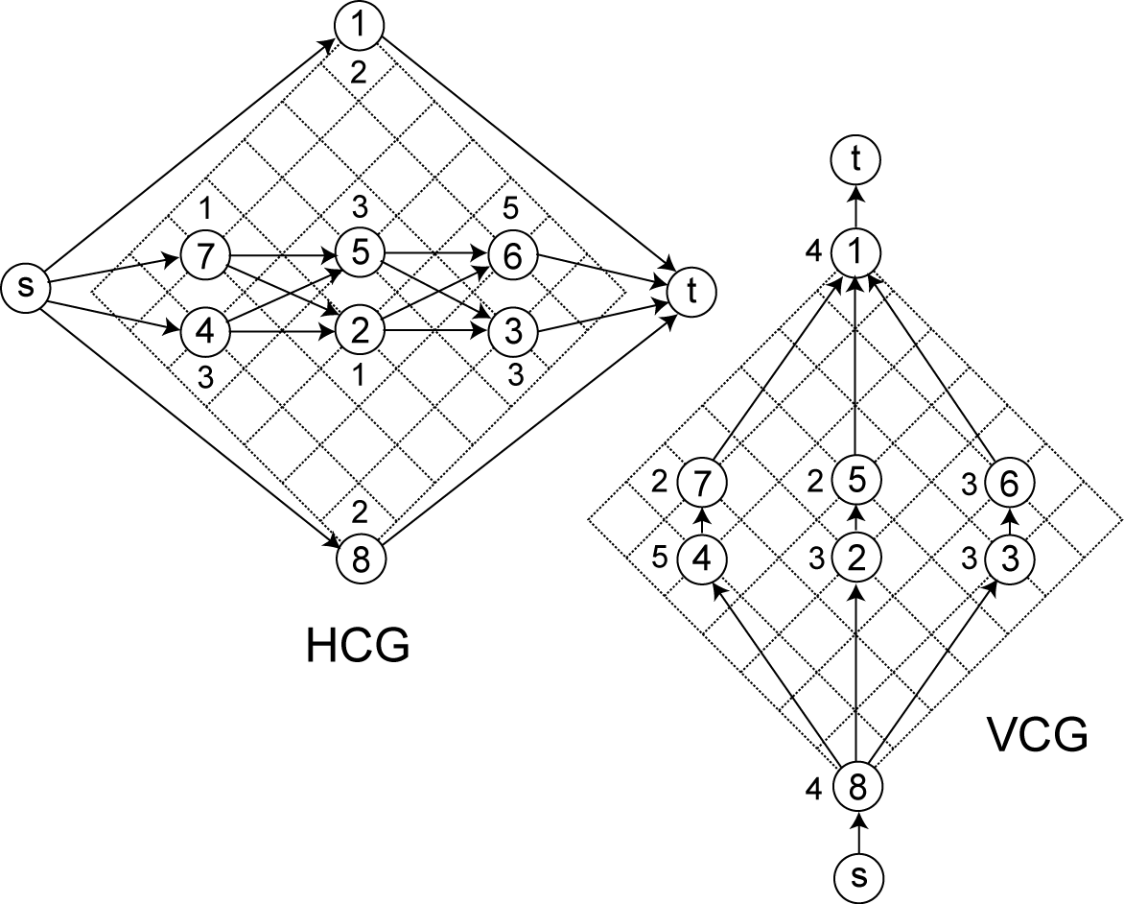
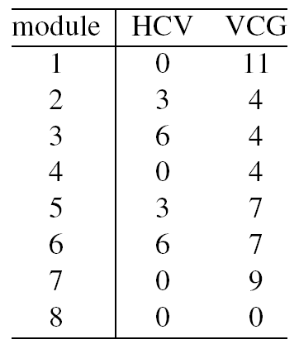
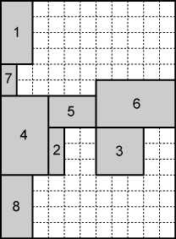

Computing Module Location
Use longest source-module path length in HCG/VCG
  Lower-left corner location = source to module input path length
Dim: 11 × 15

Slide 12
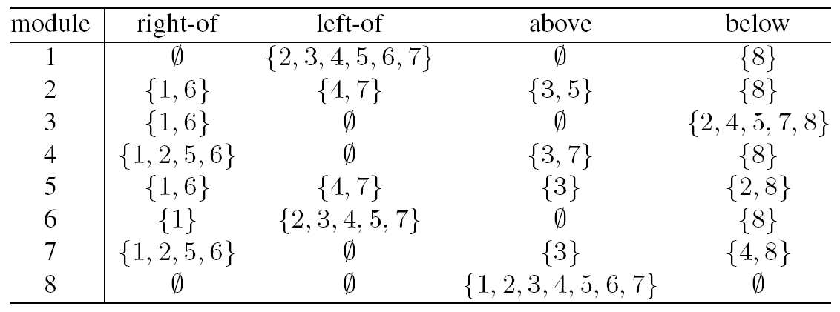
Move I (purturbation)
Swap 1 and 3 in positive sequence of SP₁
  SP₁ = (17452638, 84725361)
  SP₂ = (37452618, 84725361)

Slide 13
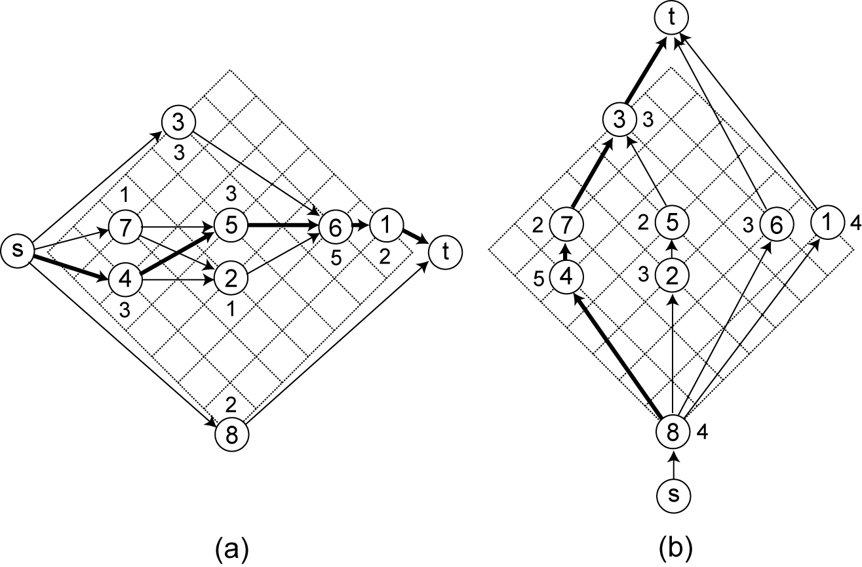
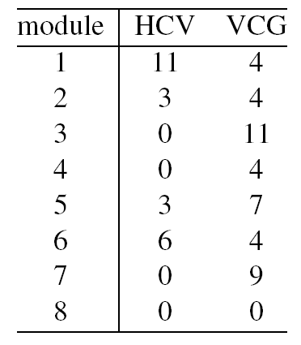
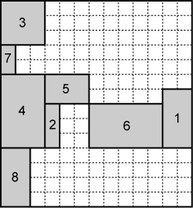
Constraint Graphs and floorplan
Dim: 13 × 14

Slide 14
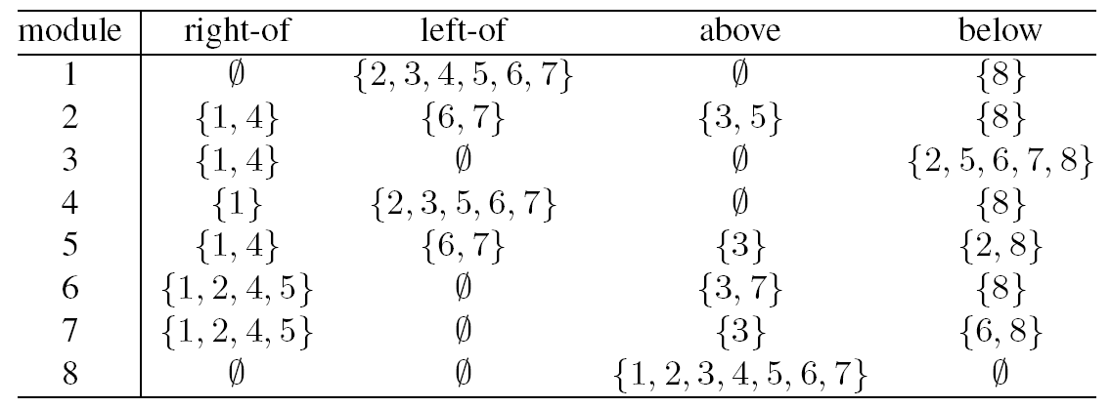
Move II
Swap 4 and 6 in both sequences of SP₂
  SP₂ = (37452618, 84725361)
  SP₃ = (37652418, 86725341)

Slide 15
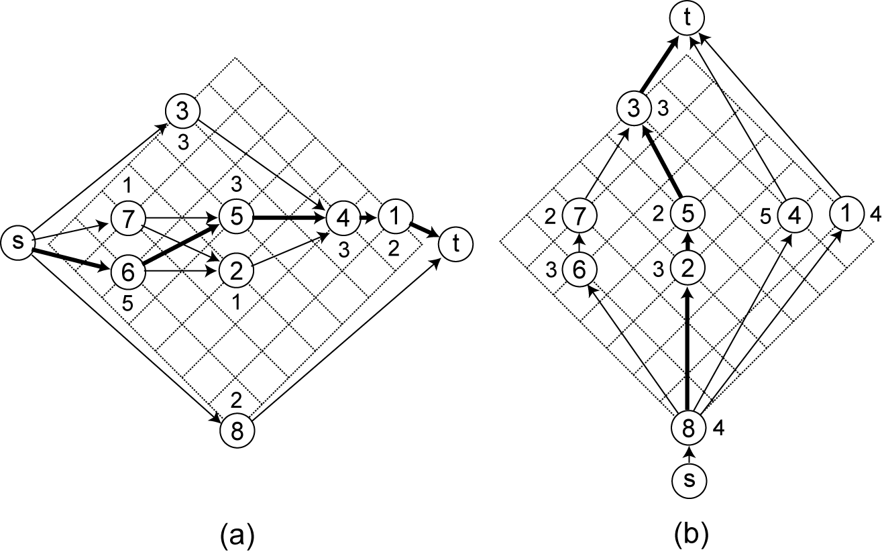
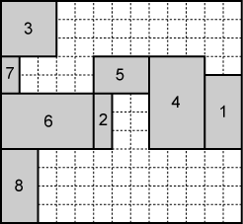
Constraint Graphs and floorplan
Dim: 13 × 12

Slide 16
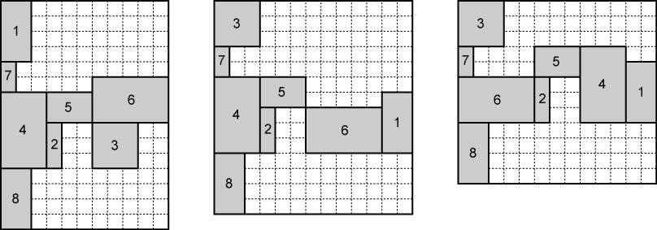
Summary (SP)
Impact of the moves:
  Floorplan dimension changes from 11 × 15 to 13 × 14 to 13 × 12

Slide 17
Placement
Problem
  Given a netlist, and fixed-shape cells (small, standard cell), find the exact location of the cells to minimize area and wire-length
  Consistent with the standard-cell design methodology
    Row-based, no hard-macros
  Modules:
    Usually fixed, equal height
    Some fixed (I/O pads)
    Connected by edges or hyperedges
Objectives
  Cost components: area, wire length
    Additional cost components: timing, congestion
Notes:
http://www.ece.umn.edu/users/kia/Courses/EE5301/
VLSI Design Automation I – © Kia Bazargan
- Note that the green module in the floorplan shown in the mid-right does not fill its “placeholder”

Slide 18
Optimization Objectives
Total Wirelength
Number of
Cut Nets
Wire Congestion
Signal
Delay
4
h
5
w
HPWL = 9

Slide 19
Placement Cost Components
Area
  Would like to pack all the modules very tightly
Wire length (half-perimeter of the net bounding box)
  Minimize average wire length
  Would result in tight packing of modules with high connectivity
Overlap
  Could be prohibited by the moves, or used as penalty
  Keep the cells from overlapping (moves cells apart)
Timing
  Not a 1-1 correspondence with wire length minimization, but consistent on average
Congestion
  Measure of routability
  Tends to move cells apart

Slide 20
Importance of Placement
Placement: fundamental problem in physical design
  Serious interconnect issues (delay, routability, noise) in nanometer design
    Placement determines interconnect to the first order
    Need placement information even in early design stages (e.g., logic synthesis)
    Need to have a good placement solution
  Placement problem becomes significantly larger
Glue of the physical synthesis

Slide 21
Design Types
ASICs
  Lots of fixed I/Os, few macros, millions of standard cells
  Placement densities : 40-80% (IBM)
  Flat and hierarchical designs
SoCs
  Many more macro blocks, cores
  Datapaths + control logic
  Can have very low placement densities : < 20%
Micro-Processor (μP) Random Logic Macros(RLM)
  Hierarchical partitions are placement instances (5-30K)
  High placement densities : 80%-98% (low whitespace)
  Many fixed I/Os, relatively few standard cells

Slide 22
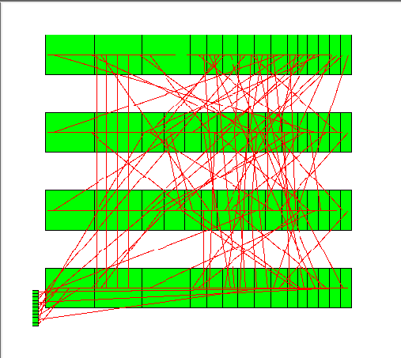
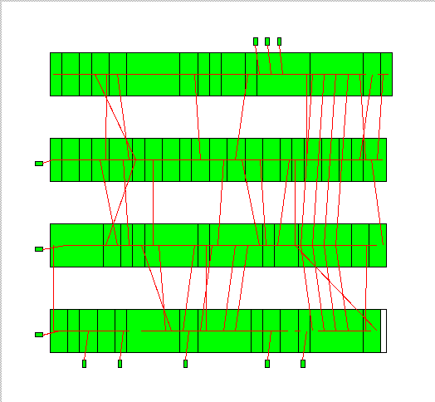
VLSI Global Placement Examples
bad placement
good placement

Slide 23
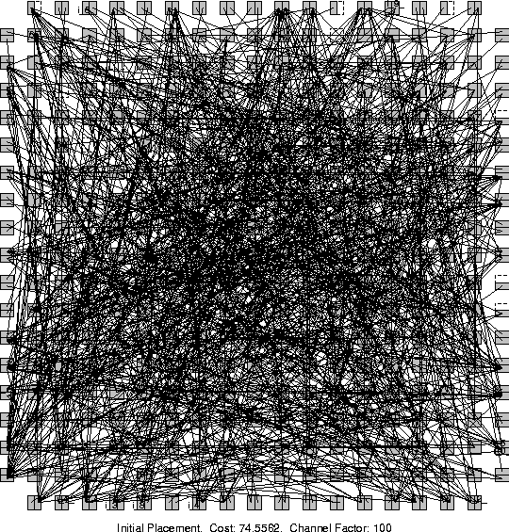
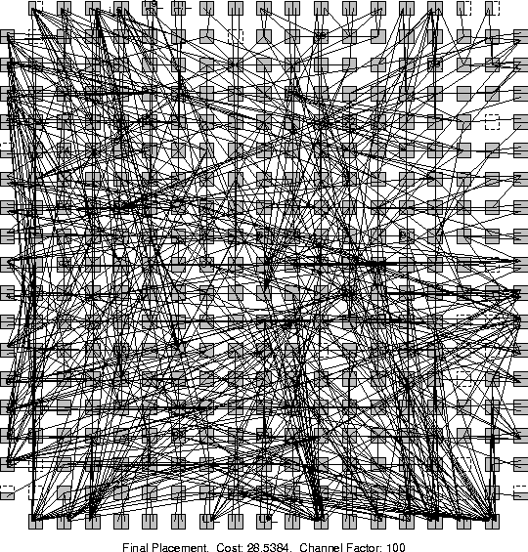
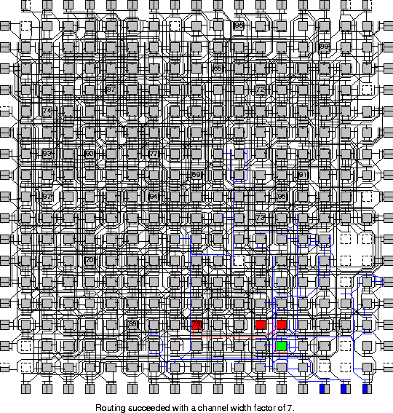
Placement can Make A Difference
MCNC Benchmark circuit e64 (contains 230 4-LUT). Placed to a FPGA.
Random Initial
Placement
Final
Placement
After Detailed
Routing

Slide 24
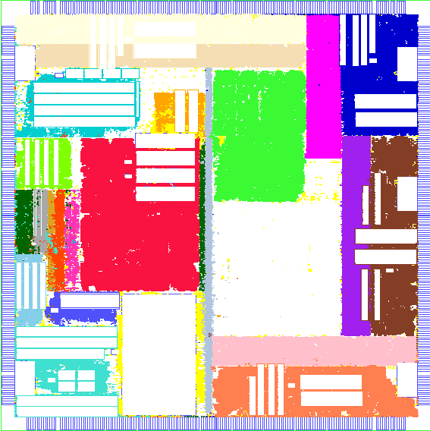
Floorplaned Placement

Slide 25
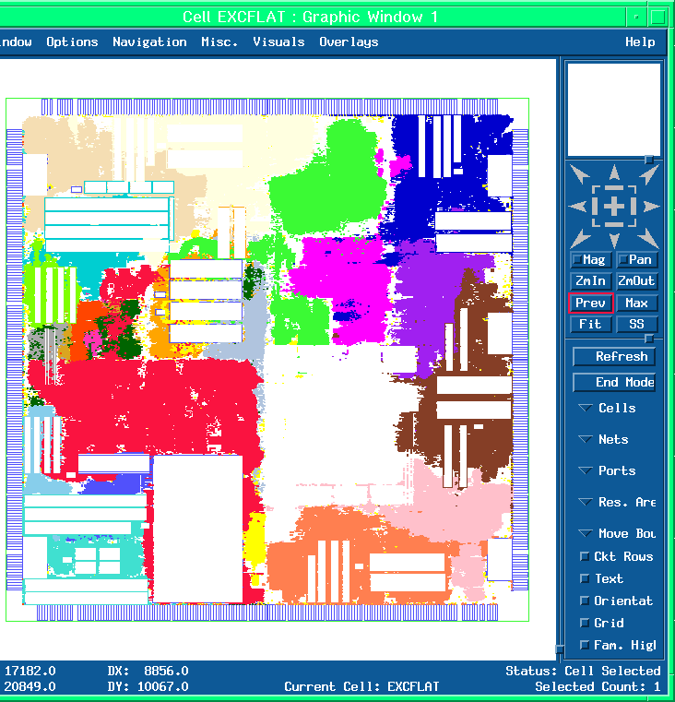
Unconstrained Placement

Slide 26
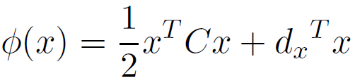
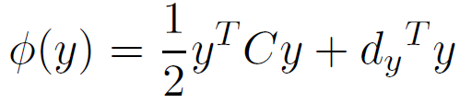
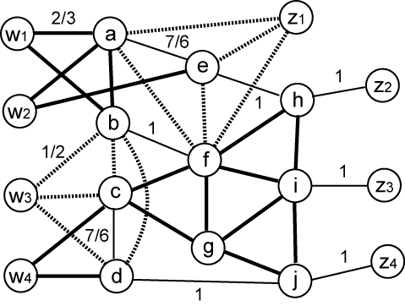
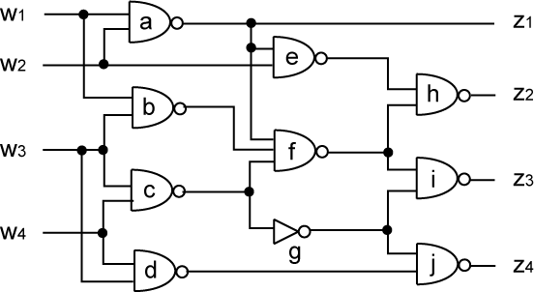
GORDIAN Placement
Minimize the squared wire-length among the cells
Perform GORDIAN placement
  Uniform area and net weight, area balance factor = 0.5
  Undirected graph model: each edge in k-clique gets weight 2/k

Slide 27
Routing
Problem
  Given a placement, and a fixed number of metal layers, find a valid pattern of horizontal and vertical wires that connect the terminals of the nets
  Levels of abstraction:
    Global routing
    Detailed routing
Objectives
  Cost components:
    Area (channel width) – min congestion in prev levels helped
    Wire delays – timing minimization in previous levels
    Number of layers (fewer layers → less expensive)
    Additional cost components: number of bends, vias
Notes:
http://www.ece.umn.edu/users/kia/Courses/EE5301/
VLSI Design Automation I – © Kia Bazargan

Slide 28
Routing Anatomy
3D
view
Top
view
Symbolic
Layout
Metal layer 3
Note: Colors used
in this slide are not
standard
Via
Metal layer 2
Metal layer 1

Slide 29
Global vs. Detailed Routing
Global routing
  Input: detailed placement, with exact terminal locations
  Determine “channel” (routing region) for each net
  Objective: minimize area (congestion), and timing (approximate)
Detailed routing
  Input: channels and approximate routing from the global routing phase
  Determine the exact route and layers for each net
  Objective: valid routing, minimize area (congestion), meet timing constraints
  Additional objectives: min via, power
Figs. [©Sherwani]

Slide 30
Taxonomy of VLSI Routers
Routers
Global
Detailed
Specialized
Graph Search
General Purpose
Power/Gnd
Restricted
Steiner
Clock
River
Maze
Iterative
Switchbox
Line Probe
Maze
Channel
Line Expansion
Hierarchical
Greedy
Left-Edge
[©Keutzer]

Slide 31
Global Routing
[©Sarrafzadeh]
Stages
  Routing region definition
  Routing region ordering
  Steiner-tree / area routing
Grid
  Tiles super-imposed on placement
  Regular or irregular
  Smaller problem to solve,
  higher level of abstraction
  Terminals at center of grid tiles
Edge capacity
  Number of nets that can pass a certain grid edge (aka congestion)
  On edge E_{ij},
  Capacity(E_{ij}) ≥ Congestion(E_{ij})
M1
M2
M3
EE 5301 - VLSI Design Automation I
Fall 2006
VI-<number>

Slide 32
Global Routing – Graph Search
Good for two-terminal nets
Build grid graph (Coarse? Fine?)
Use graph search algorithms, e.g., Dijkstra
Iterative: route nets one by one
How to handle:
  Congestion?
  Critical nets?
Order of the nets to route?
  Net criticality
  Half-perimeter of the bounding box
  Number of terminals

Slide 33
Global Routing – Maze Routing
Similar to breadth-first search
  Very simple algorithm
  Works on grid graph
  Time complexity: grid size (NxN)
Algorithm
  Propagate a “wave” from source
  until hit the sink (implemented using a queue)
  Trace back to find the path
Guaranteed to find the optimal solution
  Usually multiple optimal solutions exist
More than two terminals?
  For the third terminal, use the path between the first two as the source of the wave
5
5
4
5
4
3
5
t
4
5
3
2
3
4
5
2
1
s
1
2
3
4
5
3
2
1
2
3
4
5

Slide 34
Maze Routing
Key to popularity:
  Simplicity
  Guaranteed to find the optimal solution
  Can realize more complex cost functions too
  (e.g., number of bends in a path)
Weakness:
  Multiple terminals not handled efficiently
  Dependent on grid, a two dimensional data structure
Different variations exist
  Soukup’s alg:
    First use DFS, when get to an obstacle, use BFS to get around
    No guarantee to find the shortest path

Slide 35
Multiple Terminal Nets: Steiner Tree
Steiner tree (aka Rectilinear Steiner Tree – RST):
  A tree connecting multiple terminals
    Original points: “demand points” – set D
    Added points: “Steiner points” – set S
  Edges horizontal or vertical only
Steiner Minimum Tree (SMT)
  Similar to minimum spanning tree (MST)
  But finding SMT is NP-complete
  Many good heuristics introduced to find SMT
Algorithm
  Find MST
  Pass horizontal and vertical lines from each terminal to get the Hannan grid (optimal solution is on this grid)
  Convert each edge of the MST to an L-shaped route
  on Hannan grid (add a Steiner point at the corner of L)

Slide 36
Steiner Tree
Hannan grid reduces solution space (smaller grid)
  For min length RST, Steiner points always on Hannan grid
Convert MST to rectilinear paths
  Length bounded by 1.5 times optimal SMT length
Use alternate “L” routes to find the minimum tree
Steiner
point
MSP (length=11)
Steiner tree (len=13)
[©Sherwani]

Slide 37
Steiner Tree Routing
Can apply different costs to different regions
(or horizontal/vertical preference)
Order of the nets
  Sequential
    Use # of terminals, criticality, etc. to determine order
  Parallel
    Divide the chip into large regions, perform the routing in parallel
Key to popularity
  Fast (not theoretically, but practically)
  Bounded solution quality
Shortcomings
  Difficult to predict or avoid congestion

Slide 38
Global Routing Approaches
A combination of different approaches
might be used in chip-level routing
  Route simple nets (2-3 pins in local area) directly
  (e.g., L-shaped or Z-shaped)
  Use a “close to optimal” Steiner Tree algorithms to route nets of intermediate length
  Route remaining “big” nets using a maze router
Ordering
  Some ordering is chosen, if can route all, then done,
  otherwise:
  Rip-up and Re-route
[©Keutzer]

Slide 39
Taxonomy of VLSI Routers
Routers
Global
Detailed
Specialized
Graph Search
General Purpose
Power/Gnd
Restricted
Steiner
Clock
River
Maze
Iterative
Switchbox
Line Probe
Maze
Channel
Line Expansion
Hierarchical
Greedy
Left-Edge
[©Keutzer]

Slide 40
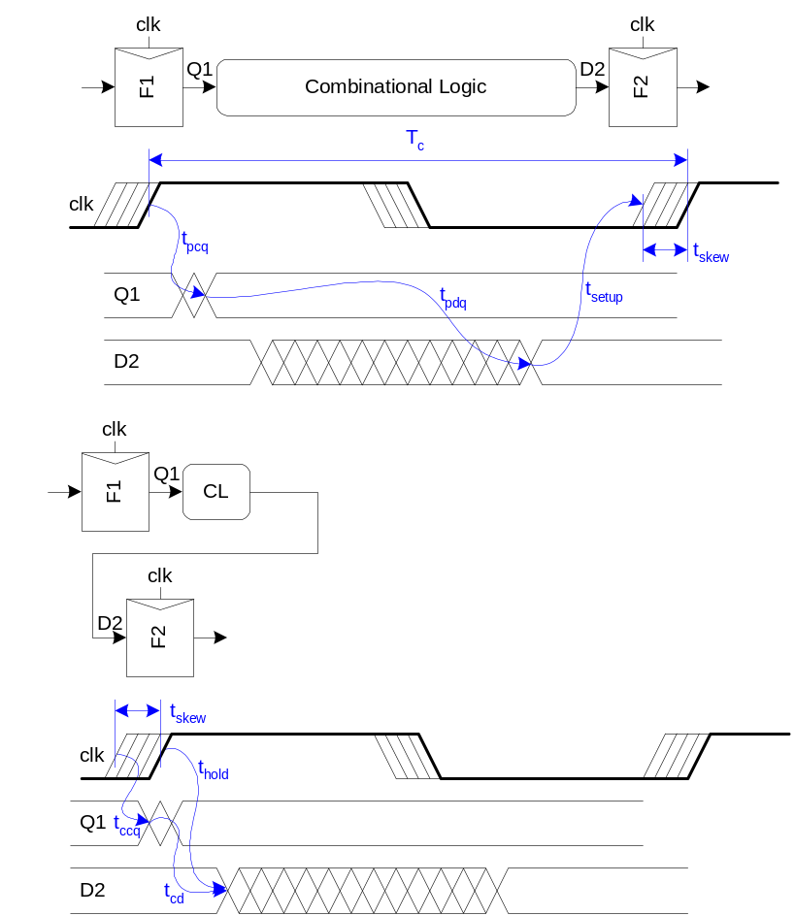
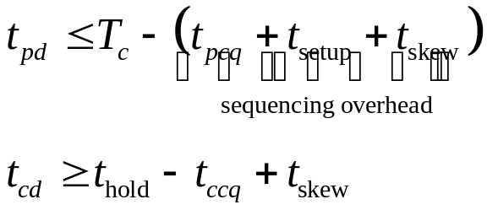
Clock Skew

Slide 41
The Clock Routing Problem
Given a source and n sinks.
Connect all sinks to the source by an interconnect tree so as to minimize:
  Clock Skew = max_{i,j} |t_{i} - t_{j}|
  Delay = max_{i} t_{i}
  Total wirelength
  Noise and coupling effect

Slide 42
Clock Design Considerations
Clock signal is global in nature, so clock nets are usually very long.
  Significant interconnect capacitance and resistance
So what are the techniques?
  Routing
    Clock tree versus clock clock mesh (grid)
    Balance skew and total wire length
  Buffer insertion
    Clock buffers to reduce clock skew, delay, and distortion in waveform.
  Wire sizing
    To further tune the clock tree/mesh

Slide 43
Clock trees
A path from the clock source to clock sinks
Clock Source
FF
FF
FF
FF
FF
FF
FF
FF
FF
FF
Notes:
The goal of a clock tree is to get the clock signal from a clock source to clock sinks. The relative arrival times, shape, and amplitude of the clock signal at the sinks need to meet certain criteria for the circuit to work correctly. Simple wires are susceptible to influences of signals in nearby wires and their own parasitics among other things that may compromise the integrity the signal and cause the signal arriving at the sinks to be unacceptable.

Slide 44
Clock trees
A path from the clock source to clock sinks
Clock Source
FF
FF
FF
FF
FF
FF
FF
FF
FF
FF
Notes:
Buffering, which restores the signal and reduces delay, helps to guarantee the integrity of the clock signal. These are the two steps that are carried out in the clock tree generation steps in the SSHAFT flow.

Slide 45
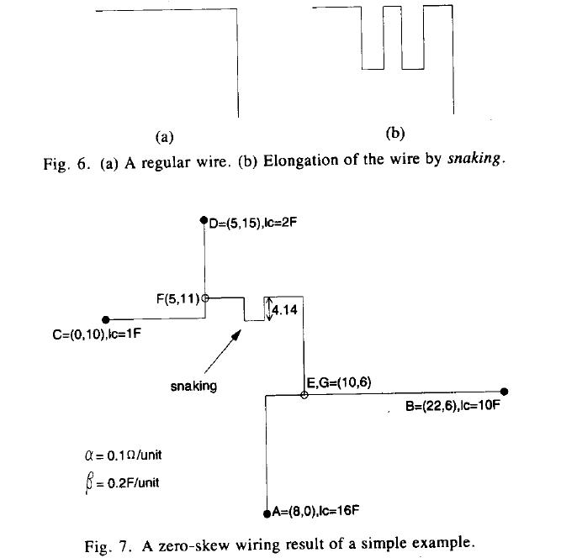
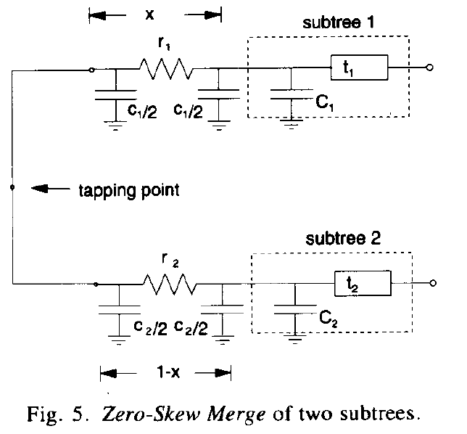
An Exact Zero Skew Algorithm [Tsay’93]
[Tsay’93]: Ren-Song Tsay, “An Exact Zero-Skew Clock Routing Algorithm”, IEEE Trans. On CAD of IC, Vol.12, No.2, 1993.

Slide 46
References
Reference 1: Chapter 12
Reference 2: Chapter 5, 6

